Slide 1

Discrete Simulation of the motion of underwater Soft Robotic Gripper
Ben Forbes
Mechanical Engineering
Premkumar Sivakumar
Mechanical Engineering

Slide 2
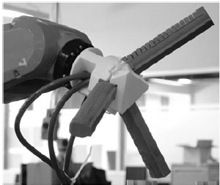
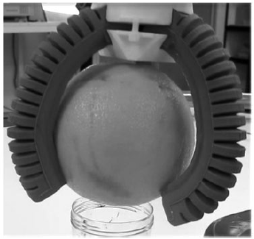
Objective
This project aims to simulate discrete motion of multi-finger soft robotic gripper especially with programmable variable stiffness for an underwater environment

Slide 3
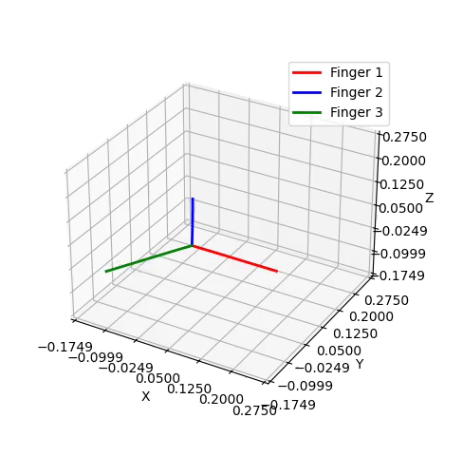
Model Setup
Each actuator finger:
Is modelled as 20 nodes connected by 19 edges
Is 20 cm long with 2 cm cross-sectional radius
Is initially in a straight rod configuration
Has material properties of Elastosil MA 4601 hyper-elastic silicone in water
Has Elastic modulus calculated based on experimental bending angle and blocking force data with pressure from literature
Uses a constant elastic stiffness (for now)

Slide 4
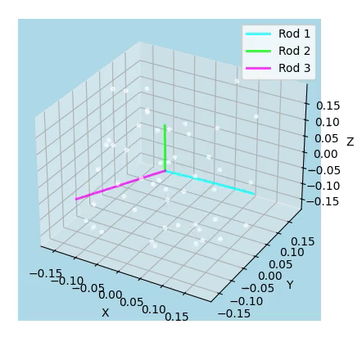
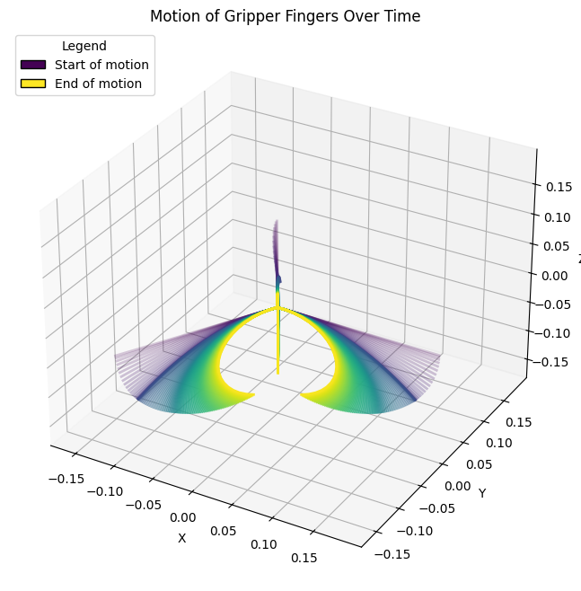
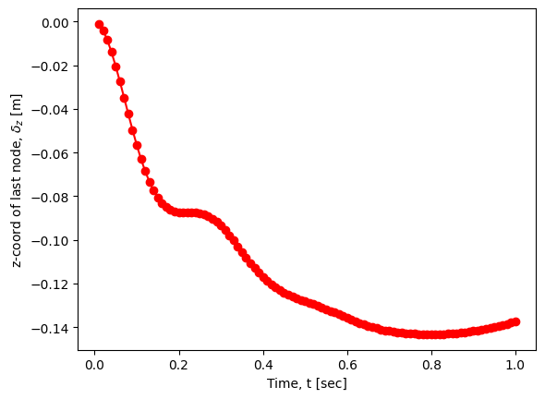
Gripper Motion Simulation
Total simulation time of 1 sec with 0.01 sec time step size
EOM : Gravitational force + viscous damping from water + elastic forces
Smooth Actuation – varying natural curvature with time (kappaBar = - 0.15 * ctime)

Slide 5
Scope of Improvement
Change the cross-sectional shape of the actuator
Incorporate contact forces to grasp an object (Predictor-Corrector method)
Program variable bending stiffness
Implement Neural ODE to predict bending stiffness
Analyze sensitivity of the material properties between Elastosil and Soft Translucent silicone

Slide 6
References
Huang, W., Huang, X., Majidi, C. et al. Dynamic simulation of articulated soft robots. Nat Commun 11, 2233 (2020). https://doi.org/10.1038/s41467-020-15651-9
Alici et al. Modeling and experimental evaluation of bending behavior of soft pneumatic actuators made of discrete actuation chambers. Soft Robotics Vol. 5, No. 1 (2018). https://doi.org/10.1089/soro.2016.0052
Hao Y, Wang T, Ren Z, et al. Modeling and experiments of a soft robotic gripper in amphibious environments. International Journal of Advanced Robotic Systems. 2017;14(3). doi:10.1177/1729881417707148
Yin Haibin, Kong Cheng, Li Junfeng, Yang Guilin. Modeling of grasping force for a soft robotic gripper with variable stiffness. Mechanism and Machine Theory, Volume 128, 2018, Pages 254-274, ISSN 0094-114X. https://doi.org/10.1016/j.mechmachtheory.2018.05.005.
Zhou, Y., Headings, L. M., and Dapino, M. J. (November 15, 2021). "Modeling of Soft Robotic Grippers Integrated With Fluidic Prestressed Composite Actuators." ASME. J. Mechanisms Robotics. June 2022; 14(3): 031001. https://doi.org/10.1115/1.4052699
Y. Zhou, L. M. Headings and M. J. Dapino, "Modeling of Fluidic Prestressed Composite Actuators With Application to Soft Robotic Grippers," in IEEE Transactions on Robotics, vol. 38, no. 4, pp. 2166-2178, Aug. 2022, doi: 10.1109/TRO.2021.3139770.
J. Shintake, V. Cacucciolo, D. Floreano, H. Shea, Adv. Mater. 2018, 30, 1707035. https://doi.org/10.1002/adma.201707035
https://newatlas.com/underwater-exploration-soft-robotic-hands/41433/

Slide 7
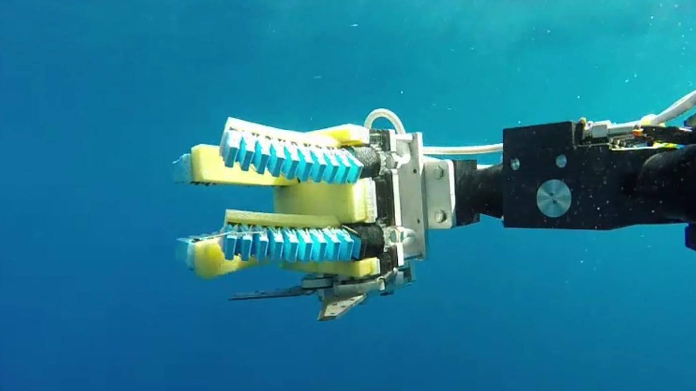
Thank you!

